Slide 1

ABSTRACT CLASS VS interface
With use cases
By:
TEAM-2

Slide 2

ABSTRACT CLASS
Java abstract class is a class that can not be initiated by itself, it needs to be subclassed by another class to use its properties.
It is designed to be a common base for other classes.
We can define a class as abstract by using the Key word – ”abstract”.
It is applicable for classes and methods in Java but not for Variables.

Slide 3
ABSTRACT CLASS
Usage:
It is limited to single inheritance and doesn’t support Multiple Inheritance.
We can define Constructors in the abstract class.
It can have abstract and non abstract methods.
Ideal for cases where you have a common base class with shared code and state.

Slide 4
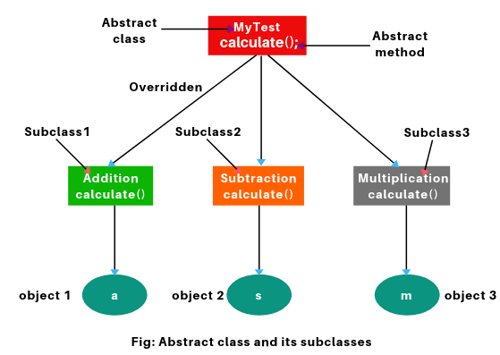
ABSTRACT CLASS
abstract class Class{
abstract int calculate();
}
class Addition extends Class {
int calculate(){return 1+2;}
}
class Subtraction extends Class{
int calculate(){return 8-1;}
}
class Multiplication extends Class{
int calculate(){return 2*2;}
}
class Main {
public static void main(String args[]){
Class b;
b=new Addition();
System.out.println(b.calculate());
b=new Subtraction();
System.out.println(b.calculate());
}
}

Slide 5
Interface
Interface is an abstract type, used to specify the behavior of a class.
It contains Static Constants and Abstract Methods.
We can support Multiple Inheritance and achieve loose coupling.
You cannot create an instance of an interface directly because an interface does not provide any implementation details.

Slide 6
INTERFACE
Usage:
It specifies methods that implementing classes must provide, without detailing the implementation.
Allows objects of different classes to be treated uniformly through the interface type.
A class can implement multiple interfaces, inheriting behaviors from various sources.

Slide 7
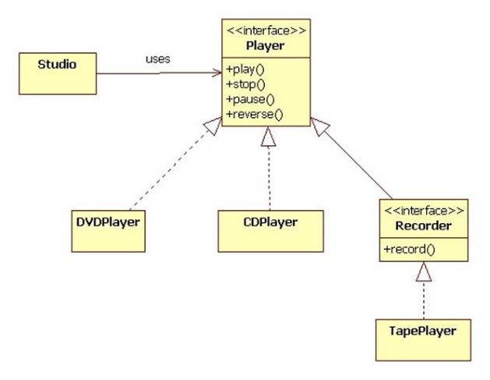
Interface

Slide 8
ABSTRACT CLASS USE CASES
Appliance Manufacturing:
An abstract class Appliance with methods like turnOn() and turnOff(), extended by concrete classes such as WashingMachine and Refrigerator.
Media Content
An abstract class MediaContent with methods such as play() and pause(), used by subclasses like Movie and MusicTrack

Slide 9
ABSTRACT CLASS USE CASES
Transport Vehicles:
An abstract class Vehicle with methods like startEngine() and stop(), implemented by concrete classes like Car and Bicycle.

Slide 10
INTERFACE USE CASES
Payment Systems:
An interface PaymentGateway with methods like processPayment() and refund(), implemented by different payment systems such as Stripe and PayPal
Event Handling:
An interface EventListener with methods like onClick() and onHover(), used by UI components like Button and Slider to handle user interactions

Slide 11
INTERFACE USE CASES
Notification Services:
An interface NotificationService with methods like sendNotification() and scheduleNotification(), implemented by classes such as EmailNotificationService and SMSNotificationService to handle different types of notifications

Slide 12
THANK YOU

